Slide 1

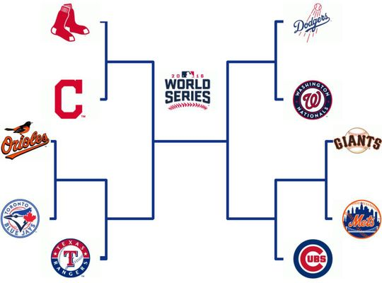
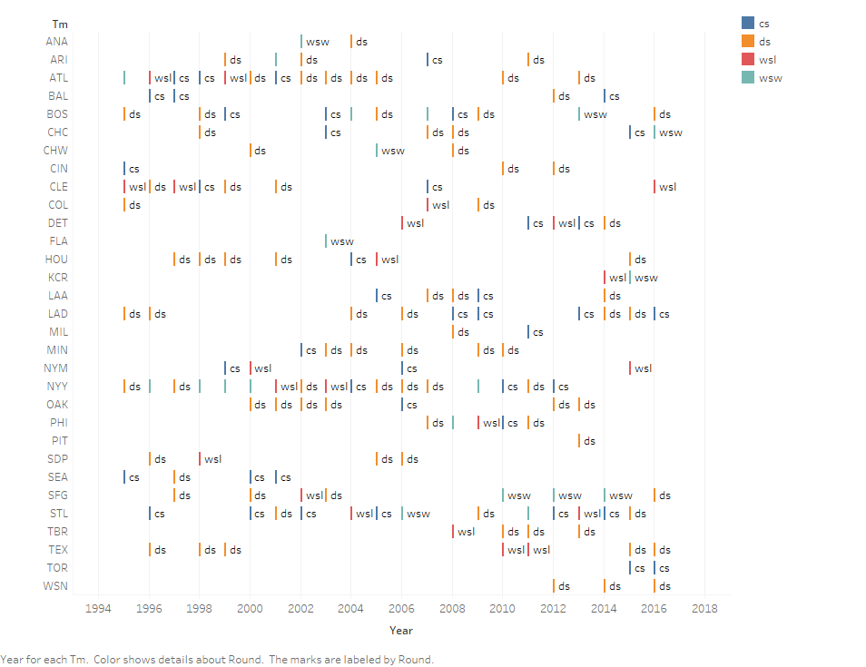
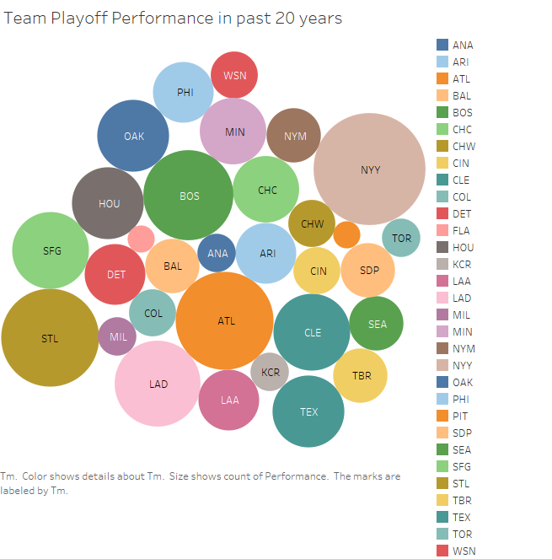
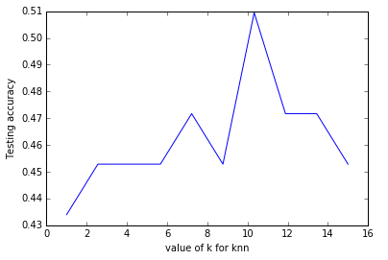

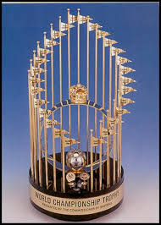
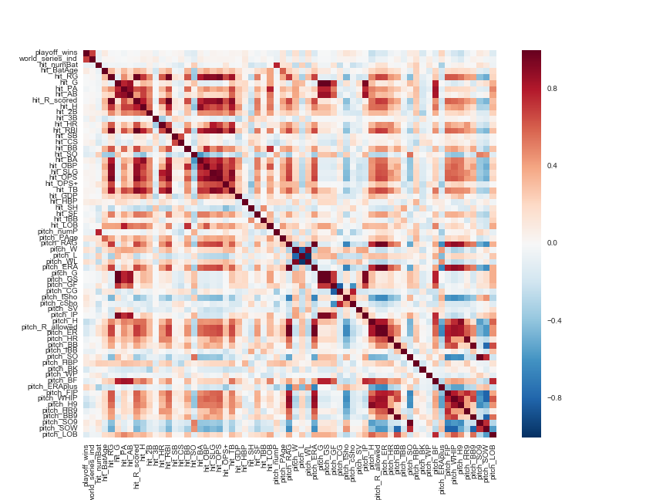
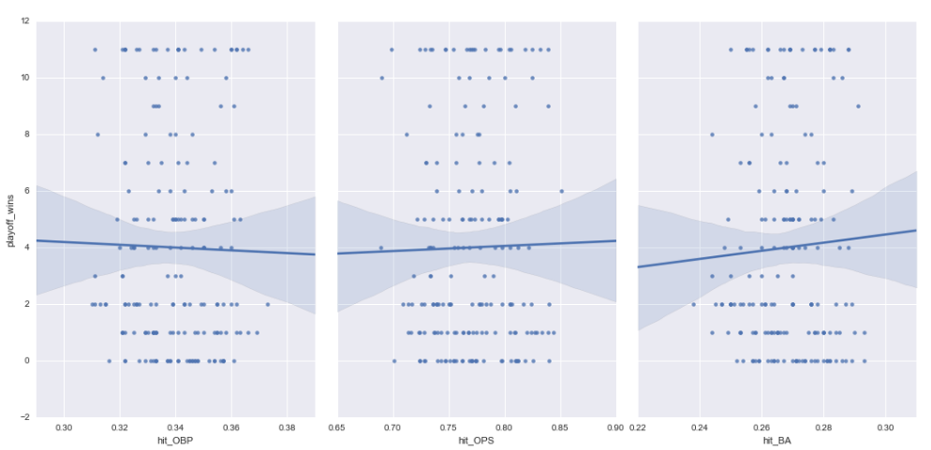


MLB World Series Performance Model
Goal
Determine which round each team will reach
Final Model
?
Earlier before applying any feature
Selection algorithm the accuracy for
All the features via KNN was 43% and for
Logistic Regression it was 47%.After Applying Feature
Selection Algorithm it as improved till 51%
Data Exploration
Algorithms
Model | Features | Accuracy | Recall | Precision | F1-Score
KNN | OBP, OPS, SLG, BA, WHIP | 50.94 % | 29.72% | 21.96% | 24.79%
Logistic | OBP, OPS, SLG, BA, WHIP | 50.94% | 25% | 12.73% | 16.87%
Model | Feature | Accuracy | Precision
KNN with k-cross validation | OBP, OPS, SLG, BA, WHIP | 51.03 % | 15.26%
Logistic regression with k-cross validation | OBP, OPS, SLG, BA, WHIP | 50.413% | 12.603%
Top -3 Teams-
(Over 20 years)
NY Yankees
ATL Braves
STL Cardinals
KNN
Graph shows that for k=10,
KNN will give highest accuracy
Data
Linear
Team statistics from 162 regular season games
Pitching and hitting statistics
Gathered from 1995 – 2016
60+ statistics gathered
Batting average, homeruns, strikeouts, wins, hits, on base percentage, ERA…
Statistics improve as teams advance in playoffs
The accuracy was only 10%
Precision – 22%
Therefore we ignored this model
Feature Selection
Methods | Features
Recursive Feature Elimination (RFE) | OBP, OPS, SLG, BA, WHIP
ExtraTrees Classifier | Pitch_H,hit_BB,hit_HR,hit_H,hit_2B)
Random Forest Regressor | hit_BB,hit_2B,pitch_H,pitch_WP,pitch_SV
Correlation matrix
Team Members:
Deepti Aggarwal
Matan Becker
Michael Costner
Rohan Singla
Mehdi Mahmoodi
Tools & References
Seaborn
Matplotlib
Py4j
Pyspark
Atexit
Train_test_split
www.baseball-reference.com

